Slide 1
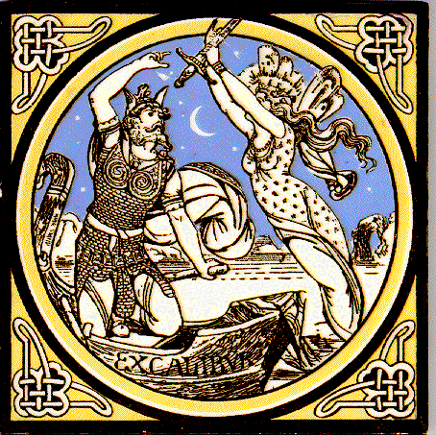
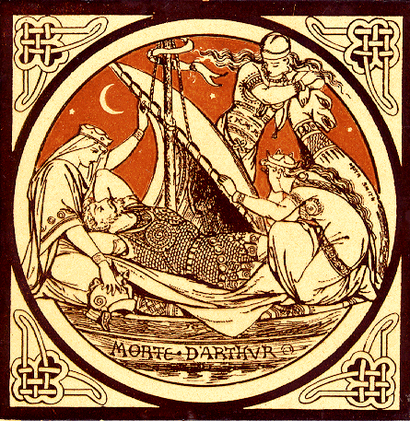
Arthurian Romance
Notes:
http://www.bbc.co.uk/history/ancient/anglo_saxons/arthur_01.shtml
http://www.lib.rochester.edu/camelot/arthmenu.htm
http://www.bl.uk/onlinegallery/onlineex/englit/malory/

Slide 2
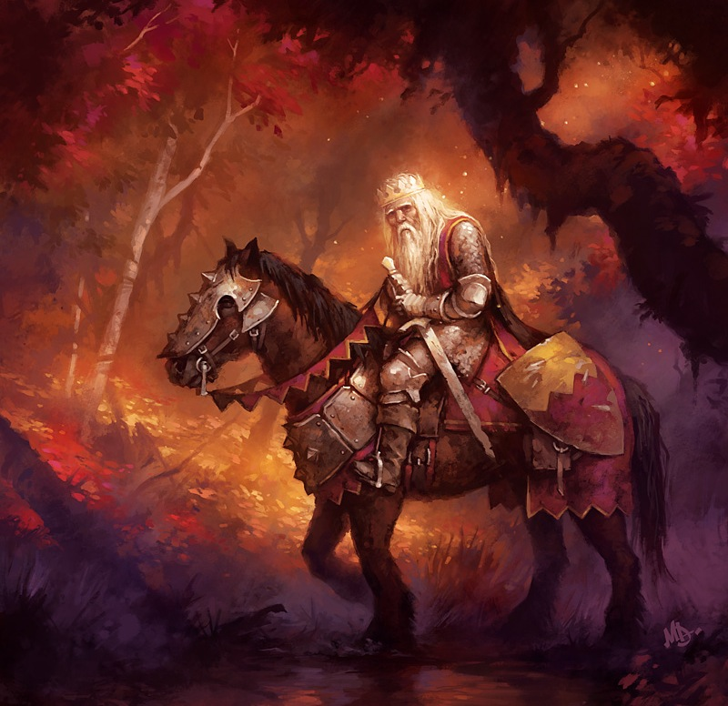
King Arthur “The once and future king”

Slide 3
King Arthur “The once and future king”
Mythical king from British folklore
Queen Guinevere
Wizard Merlin
Knights of the Round Table
Values of loyalty and chivalry
Quest for the Holy Grail

Slide 4
King Arthur “The once and future king”
A composite of different legends written by different authors at different times.
His first incarnation appears in “The History of the Britons” written in 830 by a monk called Nennius.
In the turmoil after the Norman invasion in 1066, a tradition of stories emerged in which Britons triumphed over their new masters. These stories needed a hero- this is where Arthur fits in.
Later, Geoffrey of Monmouth, a writer working at Oxford chronicled Arthur’s life in The History of the Kings of Britain.
In this work, Arthur’s whole life story is told, from his birth to his eventual betrayal and mysterious death.
Monmouth claimed the work was based on a secret lost Celtic manuscript, but really blended fact and fiction, the way the film The Da Vinci Code does today.
Notes:
http://www.bbc.co.uk/history/ancient/anglo_saxons/arthur_01.shtml

Slide 5
King Arthur “The once and future king”
A composite of different legends written by different authors at different times.
His first incarnation appears in “The History of the Britons” written in 830 by a monk called Nennius.
In the turmoil after the Norman invasion in 1066, a tradition of stories emerged in which Britons triumphed over their new masters. These stories needed a hero- this is where Arthur fits in.
Later, Geoffrey of Monmouth, a writer working at Oxford chronicled Arthur’s life in The History of the Kings of Britain.
In this work, Arthur’s whole life story is told, from his birth to his eventual betrayal and mysterious death.
Monmouth claimed the work was based on a secret lost Celtic manuscript, but really blended fact and fiction, the way the film The Da Vinci Code does today.
Notes:
http://www.bbc.co.uk/history/ancient/anglo_saxons/arthur_01.shtml

Slide 6
King Arthur “The once and future king”
A composite of different legends written by different authors at different times.
His first incarnation appears in “The History of the Britons” written in 830 by a monk called Nennius.
In the turmoil after the Norman invasion in 1066, a tradition of stories emerged in which Britons triumphed over their new masters. These stories needed a hero- this is where Arthur fits in.
Later, Geoffrey of Monmouth, a writer working at Oxford chronicled Arthur’s life in The History of the Kings of Britain.
In this work, Arthur’s whole life story is told, from his birth to his eventual betrayal and mysterious death.
Monmouth claimed the work was based on a secret lost Celtic manuscript, but really blended fact and fiction, the way the film The Da Vinci Code does today.
Notes:
http://www.bbc.co.uk/history/ancient/anglo_saxons/arthur_01.shtml

Slide 7
King Arthur “The once and future king”
A composite of different legends written by different authors at different times.
His first incarnation appears in “The History of the Britons” written in 830 by a monk called Nennius.
In the turmoil after the Norman invasion in 1066, a tradition of stories emerged in which Britons triumphed over their new masters. These stories needed a hero- this is where Arthur fits in.
Later, Geoffrey of Monmouth, a writer working at Oxford chronicled Arthur’s life in The History of the Kings of Britain.
In this work, Arthur’s whole life story is told, from his birth to his eventual betrayal and mysterious death.
Monmouth claimed the work was based on a secret lost Celtic manuscript, but really blended fact and fiction, the way the film The Da Vinci Code does today.
Notes:
http://www.bbc.co.uk/history/ancient/anglo_saxons/arthur_01.shtml

Slide 8
King Arthur “The once and future king”
A composite of different legends written by different authors at different times.
His first incarnation appears in “The History of the Britons” written in 830 by a monk called Nennius.
In the turmoil after the Norman invasion in 1066, a tradition of stories emerged in which Britons triumphed over their new masters. These stories needed a hero- this is where Arthur fits in.
Later, Geoffrey of Monmouth, a writer working at Oxford chronicled Arthur’s life in The History of the Kings of Britain.
In this work, Arthur’s whole life story is told, from his birth to his eventual betrayal and mysterious death.
Monmouth claimed the work was based on a secret lost Celtic manuscript, but really blended fact and fiction, the way the film The Da Vinci Code does today.
Notes:
http://www.bbc.co.uk/history/ancient/anglo_saxons/arthur_01.shtml

Slide 9
King Arthur “The once and future king”
A composite of different legends written by different authors at different times.
His first incarnation appears in “The History of the Britons” written in 830 by a monk called Nennius.
In the turmoil after the Norman invasion in 1066, a tradition of stories emerged in which Britons triumphed over their new masters. These stories needed a hero- this is where Arthur fits in.
Later, Geoffrey of Monmouth, a writer working at Oxford chronicled Arthur’s life in The History of the Kings of Britain.
In this work, Arthur’s whole life story is told, from his birth to his eventual betrayal and mysterious death.
Monmouth claimed the work was based on a secret lost Celtic manuscript, but really blended fact and fiction, the way the film The Da Vinci Code does today.
Notes:
http://www.bbc.co.uk/history/ancient/anglo_saxons/arthur_01.shtml

Slide 10
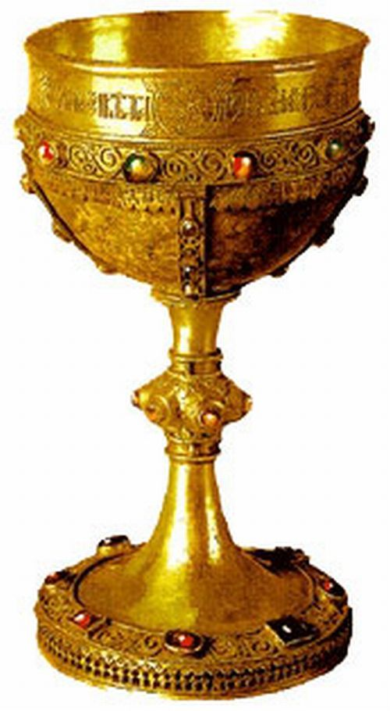
The Holy Grail
Chrétien de Troyes, a French writer turned the Arthur legend from a tale of romance to a spiritual quest.
A girl came in, fair and comely and beautifully adorned, and between her hands she held a grail. And when she carried the grail in, the hall was suffused by a light so brilliant that the candles lost their brightness as do the moon or stars when the sun rises…The grail was made of the finest pure gold, and in it were set precious stones of many kinds, the richest and most precious in the earth or the sea.
Chrétien’s image of the grail became the mystical symbol of all human quests, of the human yearning for something unattainable
Notes:
http://www.bbc.co.uk/history/ancient/anglo_saxons/arthur_01.shtml
http://www.lib.rochester.edu/camelot/arthmenu.htm
http://www.bl.uk/onlinegallery/onlineex/englit/malory/

Slide 11
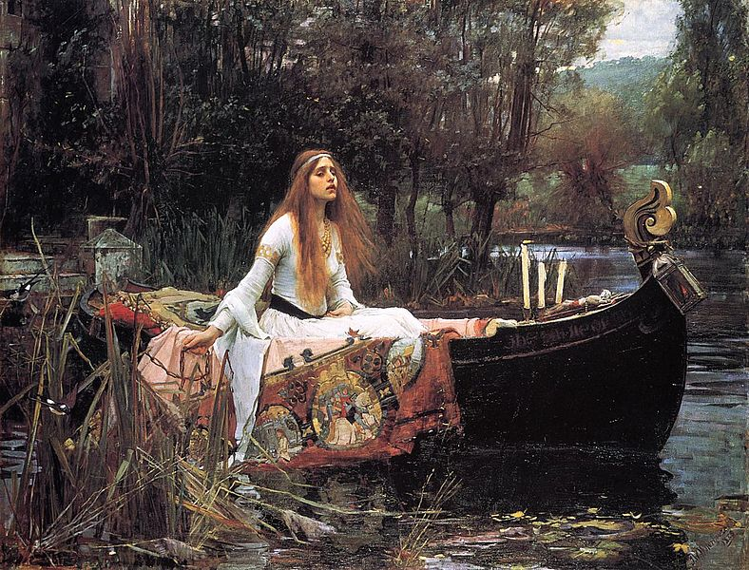
Romance
A type of verse narrative that traces the adventures of a brave knight or hero who overcomes danger for the love of a lady or some other high ideal
The normal laws of nature are suspended

Slide 12
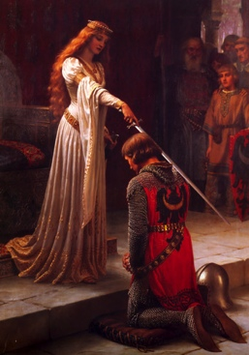
The Romance Hero
Idealized hero who fights against the forces of evil
Usually aided by magic
Born under mysterious circumstances
Grows up in obscurity
Childhood initiation involving a magic weapon
Has a wise mentor
Death is mysterious, suggests he may return

Slide 13
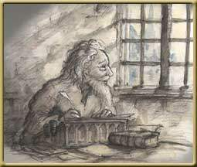
Sir Thomas Malory ”The Knight Prisoner” 1405 – 1471
Malory led the unremarkable life of a country gentleman until, in 1450, for unknown reasons he turned to a life of crime.
Malory was one of many who exploited the breakdown of law and order in the Middle Ages.
He extorted money and stole livestock.
With a small army he attacked Combe Abbey, terrifying the monks and stealing their valuables.
He was arrested, escaped twice, but spent most of the 1450s in prison
While in prison he wrote Le Morte d’Arthur

Slide 14
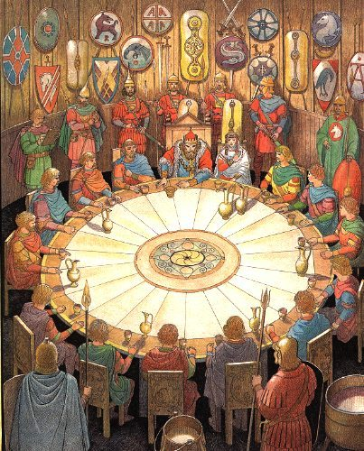
Le Morte d’Arthur
Malory’s version of the tale is one of the most popular
Malory’s Le Morte d’Arthur is a tale of the birth, education, adventures and death (or disappearance) of King Arthur.
Arthur and his knights unite in the fellowship of the Round Table
For a while, Arthur’s noble vision is realized and justice prevails in the kingdom
Gradually human frailties corrupt the order

Slide 15
The erosion of values
During the 1400s, central government in England was weak under Henry VI, who suffered from bouts of insanity.
Local disorder thrived. Richard, Duke of York ruled as Regent during the illness of Henry VI, who came from the house of Lancaster. When Henry recovered in 1455, Richard didn’t want to relinquish power.
Civil war broke out as the houses of York and Lancaster fought for the throne during the Wars of the Roses.
During this period of bloody civil war, old values like honor and loyalty began to erode. It was this erosion of values that gave birth to Malory’s Le Morte d’Arthur

Slide 16
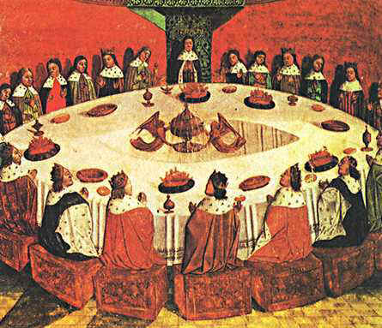

Slide 17
The erosion of values
Arthur, the good king of Britain, whose valor teaches us that we too should be courteous and brave, was holding court with all kinglike splendor at Carlisle in Wales on that feast so worth its cost one has to call it Pentecost.
After dinner the knights gathered again here and there through the halls where the ladies, married or unmarried, called them. Some knights talked of recent events; others were speaking of love, the tribulations and the sorrows and the blessings that often come to the disciples of his order. At that time Love's order was still fine and flourishing. Now, alas, there are very few disciples; nearly all have deserted him so that Love is held in disrepute. In olden days Love's disciples were known for courtesy and bravery, generosity and honor. Now love has become an idle word. Those who know nothing of his order maintain they love; but they lie. They have no right to talk. In their boasting, love is but an idle tale and a lie.
But now let us speak of those who once were and leave aside those who still are, for a courteous man, though dead, is worth a great deal more, in my opinion, than a living churl. So it is my pleasure to relate a story worth listening to about the king whose fame spreads near and far. And I do agree with the belief of so many Bretons that his renown will last forever. Thanks to him, people will recall his chosen knights, fine men who strove for honor.
-Chretien de Troyes

Slide 18
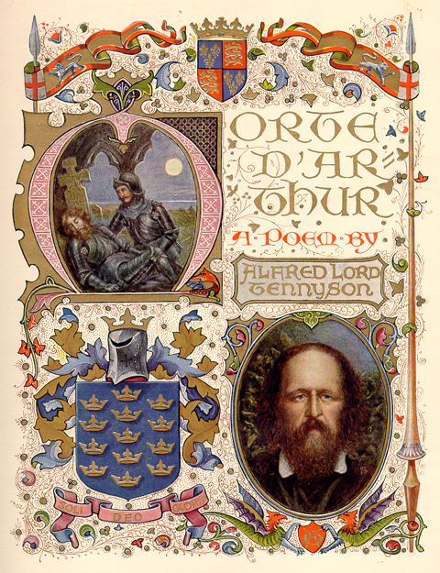
Victorian Revival
The 19th century in Britain was a time of great change. The Industrial Revolution was quickly transforming the nation.
Times of great unrest and change such as this created great doubt and uncertainty in people’s minds.
People longed for stability and for a hero.
The Legend of King Arthur, the unfaltering goodness and the moral stability of Camelot became very popular.
19th century writers like Alfred Lord Tennyson composed poetry based on the myth.
Notes:
http://www.bbc.co.uk/history/ancient/anglo_saxons/arthur_01.shtml

Slide 19
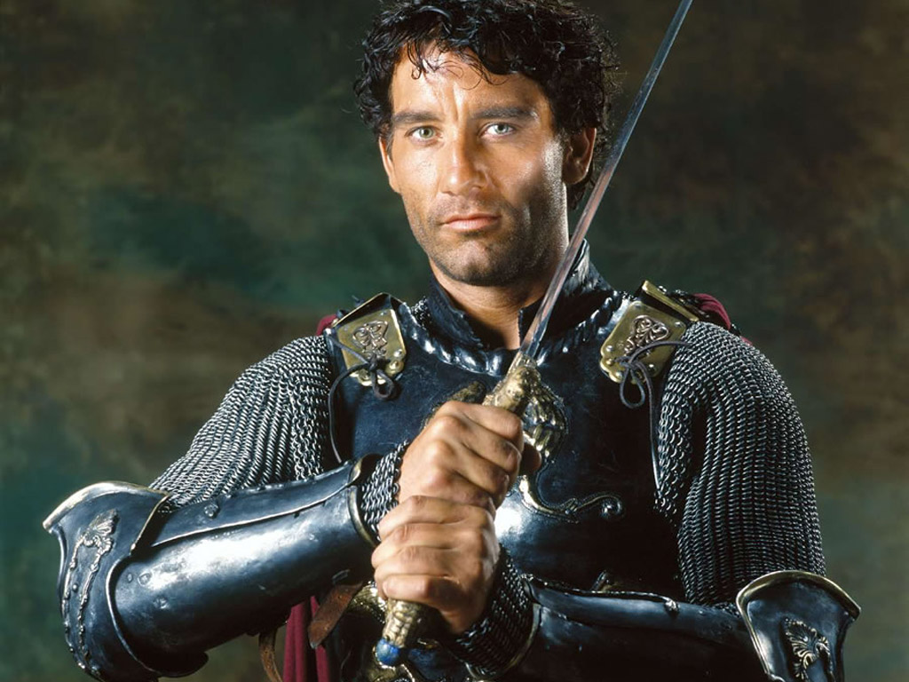
The Modern Myth
Camelot was “discovered” in Somerset in the 1960s.
Films such as Lancelot (1972), Excalibur (1981), First Knight (1995) were the precursors to Hollywood’s 2004 epic film King Arthur
When English peoples need a hero, King Arthur is resurrected.
Notes:
http://www.bbc.co.uk/history/ancient/anglo_saxons/arthur_01.shtml

Slide 20
Was King Arthur real?
This is a question many have asked but none have answered credibly.

Slide 21
